Slide 1
OPS245 Week 2
Jonathan.ye@senecacollege.ca
Notes:
Review, preview and explain both of Linux administration and Python scripting

Slide 2
Virtualization
Virtual machine is a simulated environment of a computing system.
VM is a file in the host system
Host system name is hypervisor: type 1 and 2
Notes:
Top3 vendors are VMWare, Citrix and MS Hyper V.

Slide 3
Advantages of virtualization
Remove dependency of hardware
Extend legacy system working life
Easy to backup and restore (more layers and options)
Need to understand and learn:
What it is?
How to create and manage VM in both own hypervisors and cloud-based platforms.
Notes:
Amazon, Google and Microsoft are the top 3 cloud service providers in North America

Slide 4
Python and programming language
Programming language can be used for:
AI and machine learning. ...
Data analytics. ...
Data visualisation. ...
Programming applications. ...
Web development. ...
Game development. ...
Language development. ...
Finance.
Notes:
Any application programs or Operating systems are “made” by certain computing language.

Slide 5
Automation in Linux administration
Bash scripts
Python
Commands
Automatically (scheduled) tasks
Notes:
Find information how you can plan and arrange automation in Linux administration.

Slide 6
Start Python on Linux system
We are using python3 (forget older version please)
Download and install (depending on your Linux distro)

Slide 7
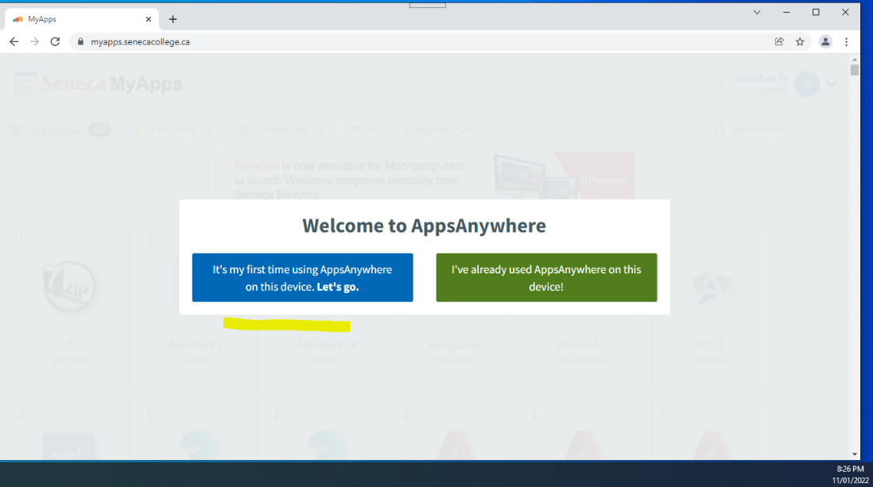
Log into myapps.senecacollege.ca
Notes:
Download and install AppsAnywhere before you can install VMWare Workstation V16

Slide 8
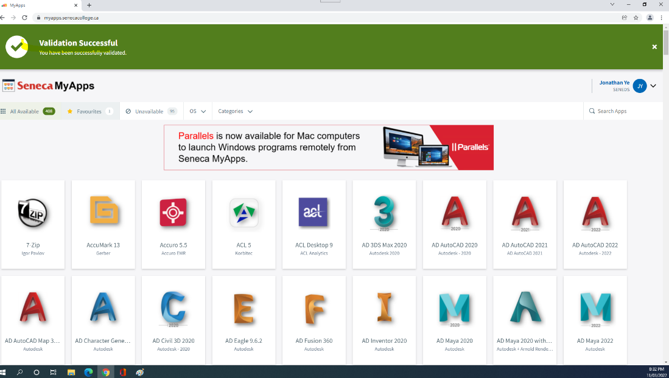
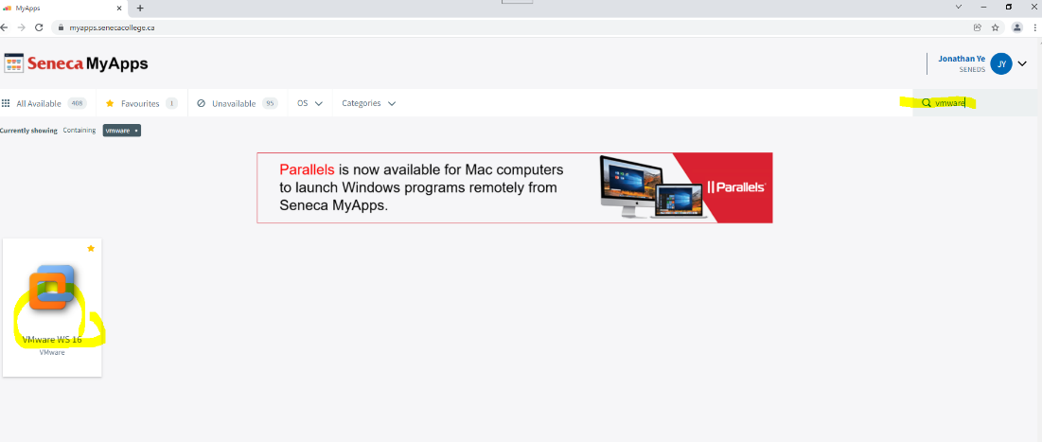
Search and install Vmware WS16

Slide 9
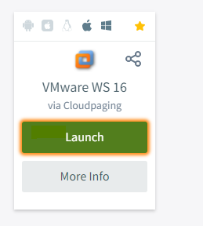
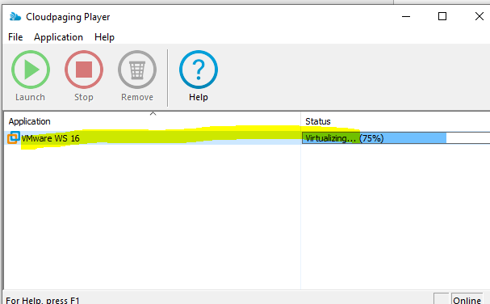
VMWare WS16
Notes:
Cloudpaging Player will start initializing the app on my computer:

Slide 10
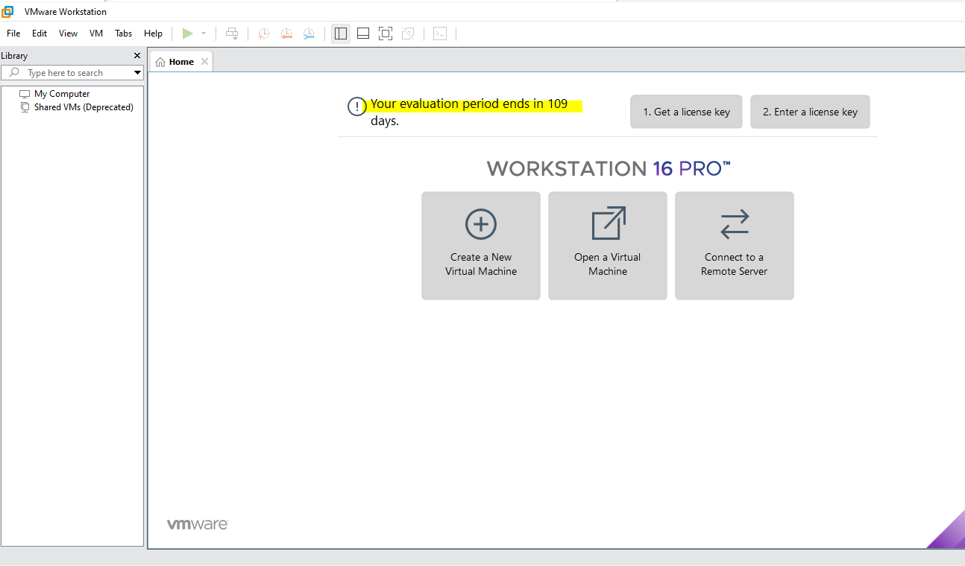
The VMWare WS16
Notes:
I connect the USB SSD and format it with exFAT in the previous section. Click Create a New Virtual Machine in the VMware WS16

Slide 11
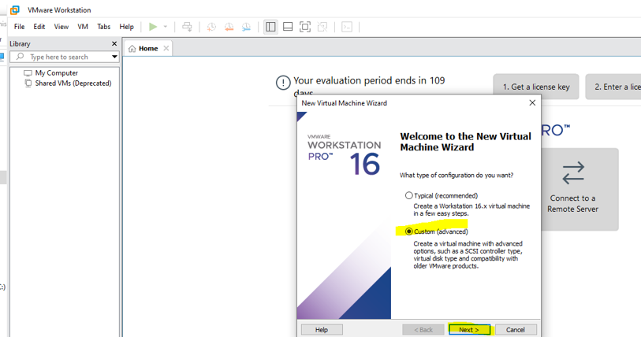
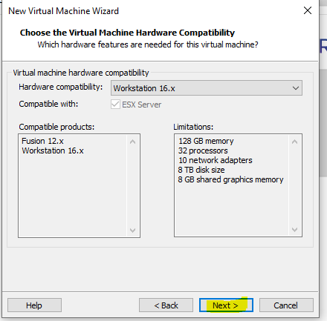
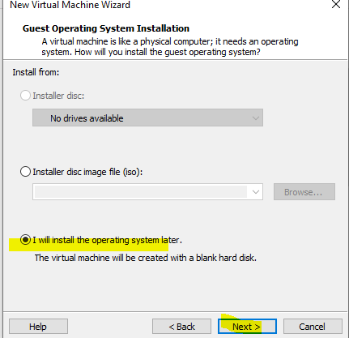
Start building VM

Slide 12
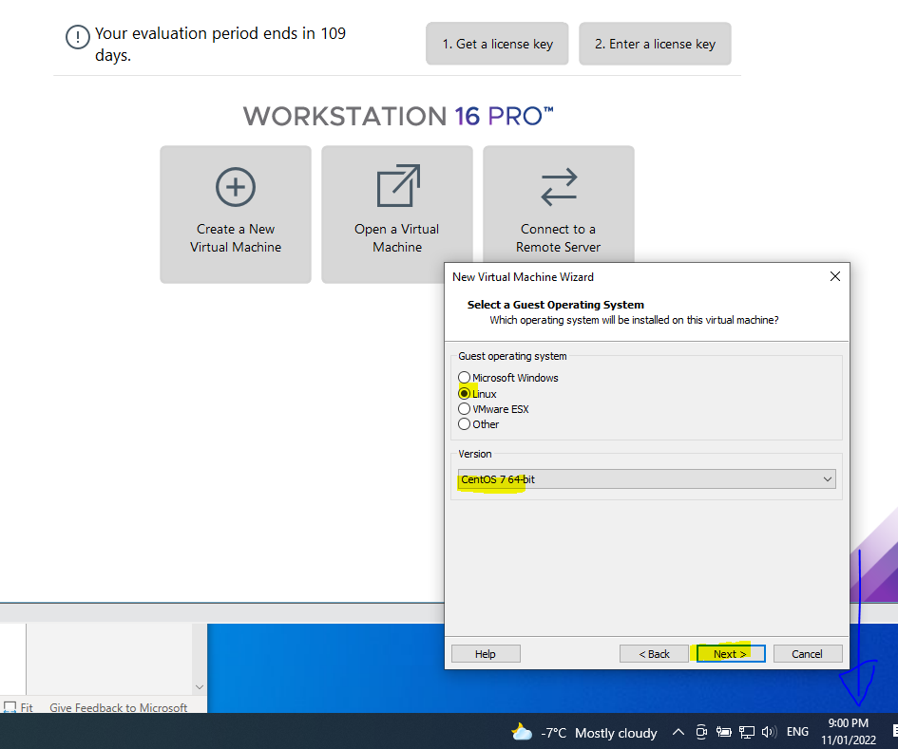
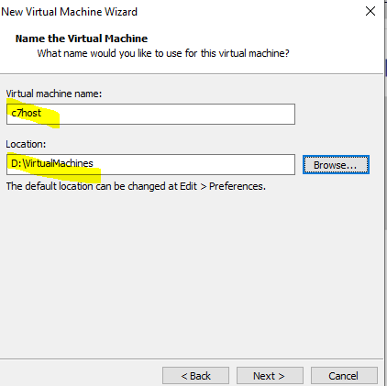
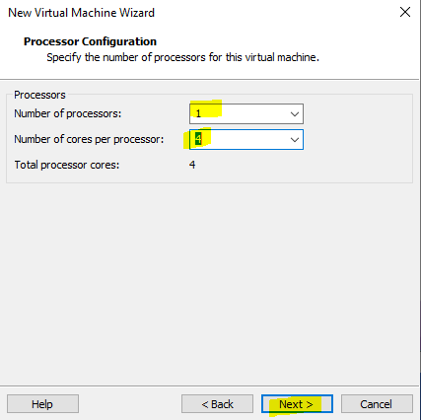
Install Linux OS in the VM
I used the browse button to change the Location while I give the virtual machine name: c7hos (Note, my folder name does not have a space. It is D:\VirtualMachines)

Slide 13
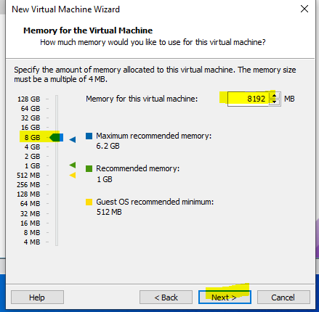
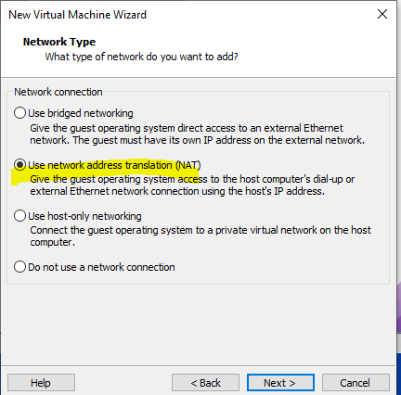
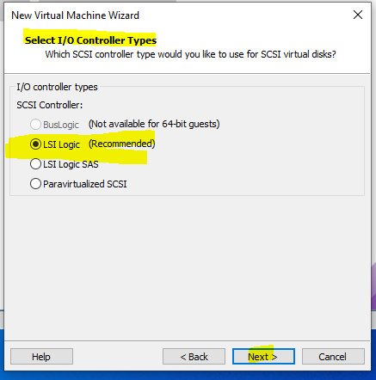
VM has Linux OS

Slide 14
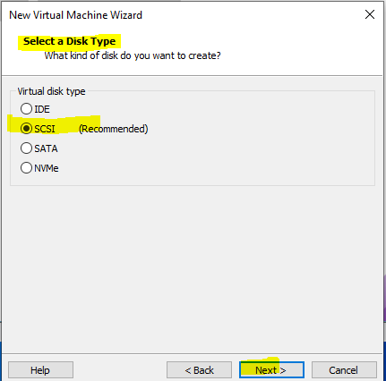
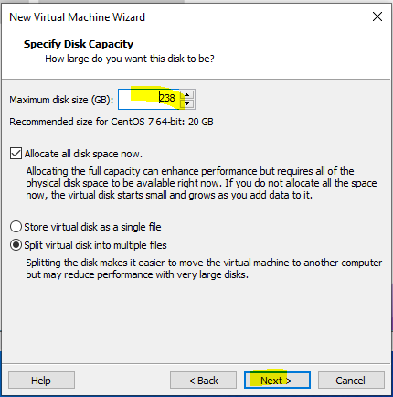
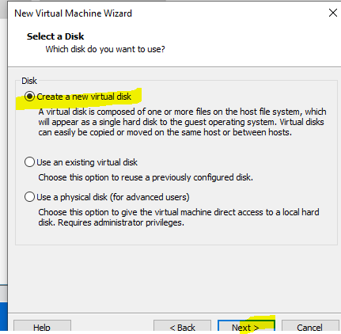
Disk selection screenshots
Notes:
Refer lab1 for the detailed instruction

Slide 15
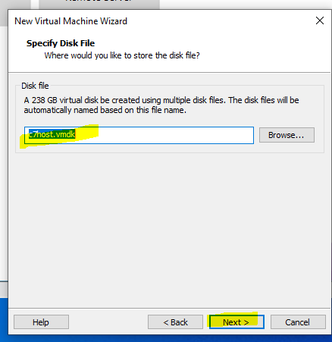
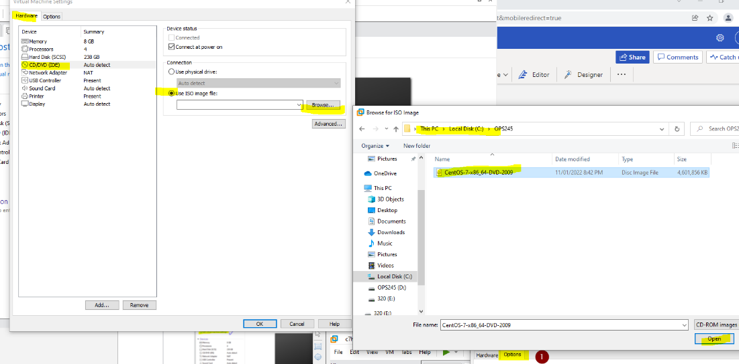
Do not power on and you need EDIT
Notes:
I do NOT power on and start Edit virtual machine settings!!!

Slide 16
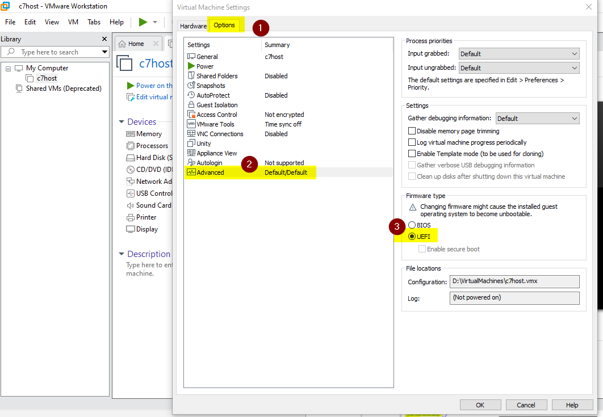
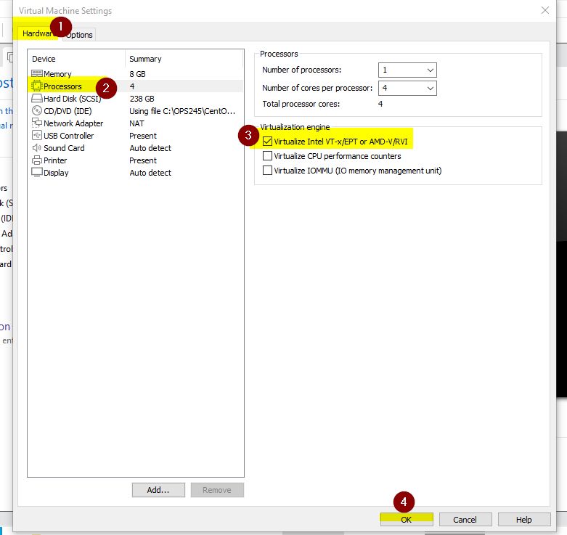
Edit setup before power on the C7host

Slide 17
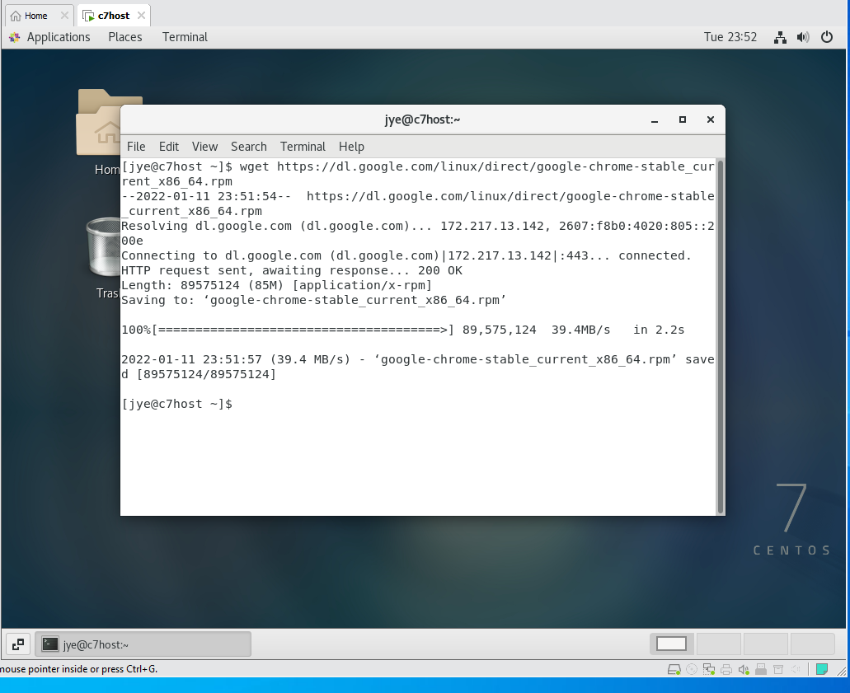
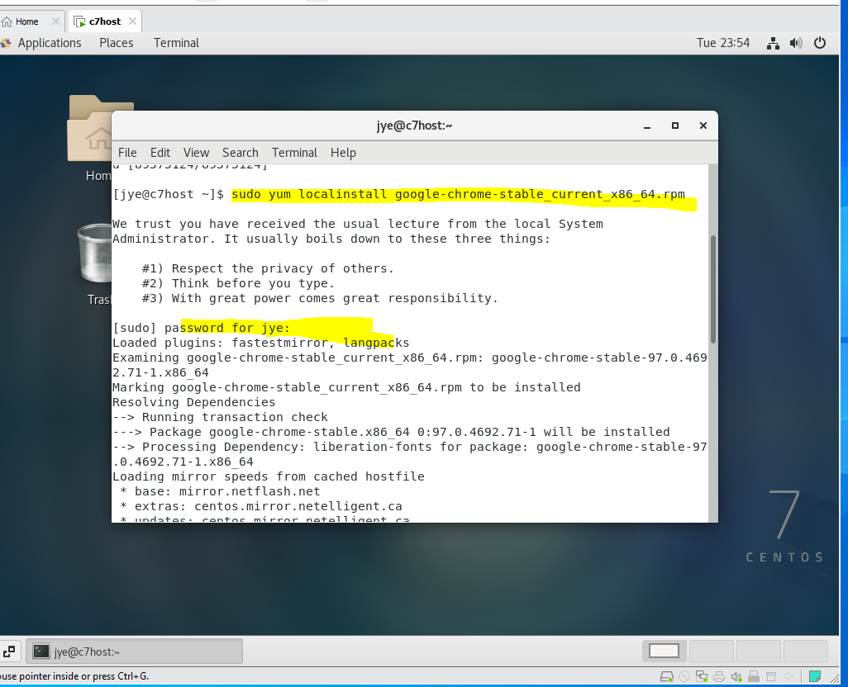
Practice app installation in CentOS
Notes:
To download and install Google chrome

Slide 18
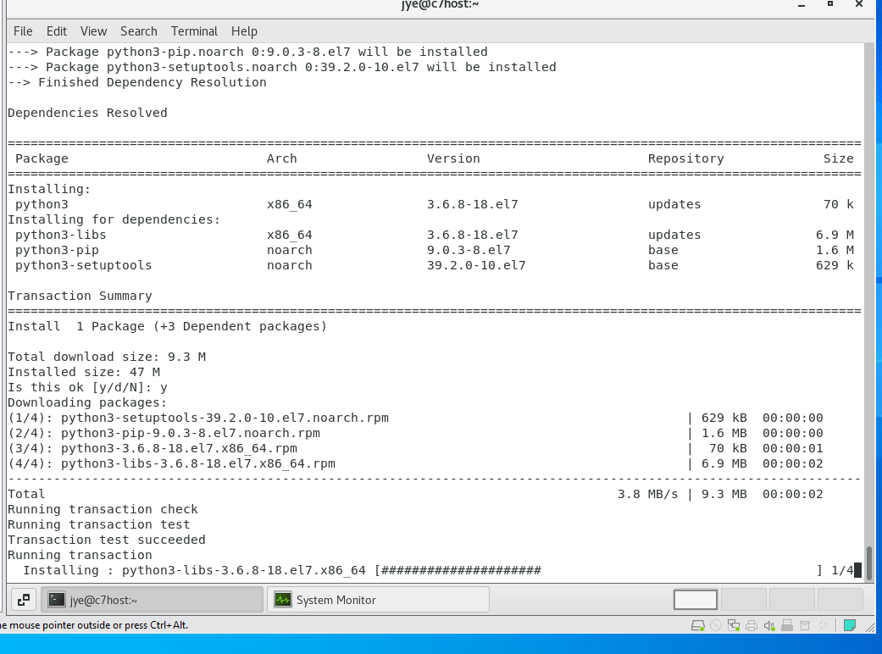
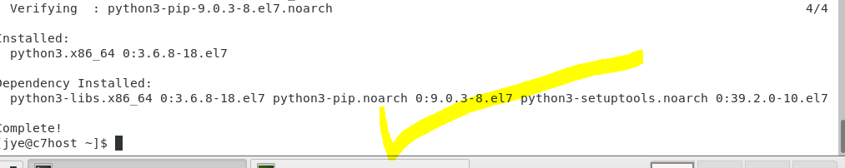
Install Python
Notes:
Run the command sudo yum install python3
I do not need to teach how to create a file in Linux by touch, echo, > or cat >, etc ,etc

Slide 19
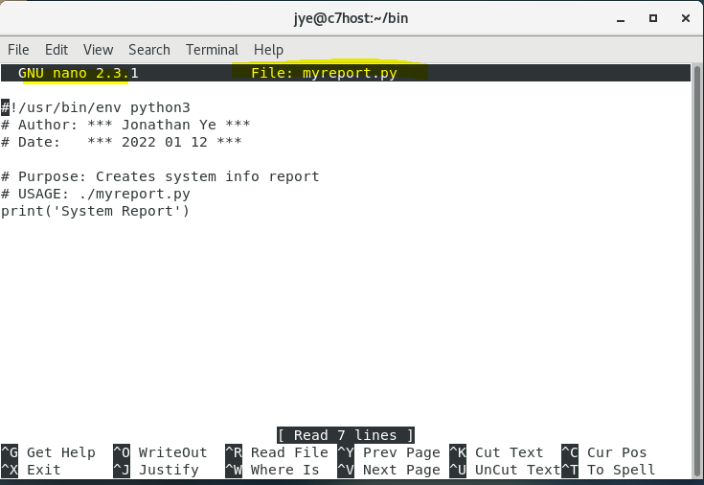
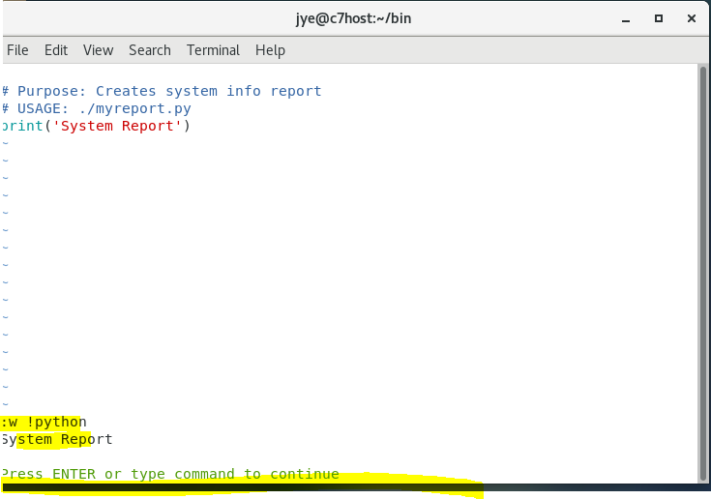
Create Python files
Notes:
I do not need to teach how to create a file in Linux by touch, echo, > or cat >, etc ,etc
We can vim , nano or emacs to edit the python file

Slide 20
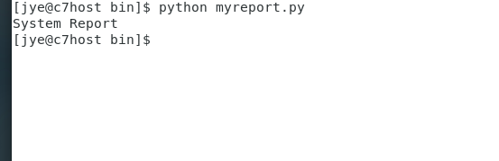
Change permission and execute Python
Notes:
execute the script in terminal

Slide 21
Sample code explanation
# Purpose: Creates system info report
# USAGE: ./myreport.py
import os
myHostName = os.uname();
print('System Report');
print (myHostName);

Slide 22
Question
???
Notes:
I cannot promise you to answer your email the same day. But, I will answer your question in the class imm.

Slide 23
Mini homeworks
No mark or bonus. But, good to do:
Find 3 Linux administration troubles and solutions
Find at least 3 distros of Linux. See if there is any difference to install apps.

